Slide 1
Implementation of a membership Algorithm for Context Free Languages
By :
Alex Cook
Ji Kim
Al Julanda Al Mahfudhi

Slide 2
Problem Description
Inputs :
CFG
String
Determine algorithmically if the given string can be generated by the given CFG

Slide 3
Approach to Solving
We will be using C++ to implement the algorithm. The breakdown of tasks for each step is as follows:
Steps to Convert CFG to CNF
1. Eliminate lambda productions
2. Eliminate Unit productions
3. Eliminate non-terminating and unreachable productions

Slide 4
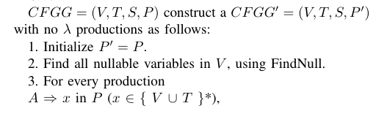
CFG to CNF in Detail
Eliminate lambda production:

Slide 5
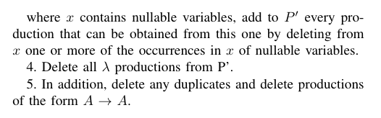
CFG to CNF in Detail(cont.)
Eliminate lambda production (cont.):

Slide 6
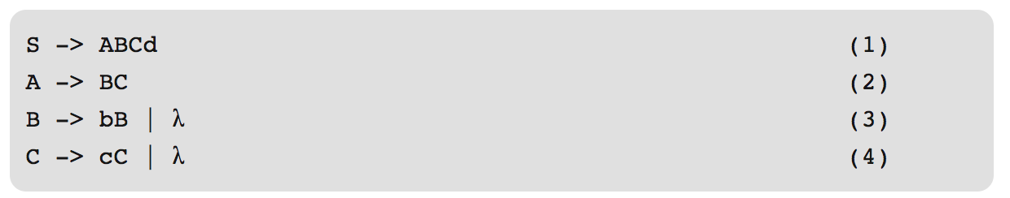
CFG to CNF in Detail(cont.)
Eliminate lambda production (cont.):

Slide 7
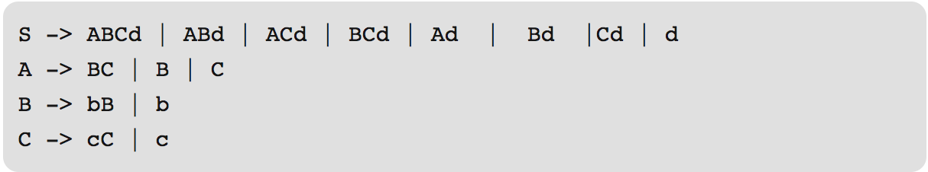
CFG to CNF in Detail(cont.)
Eliminate lambda production (cont.):

Slide 8
CFG to CNF in Detail(cont.)
Eliminating Unit Productions:
Example
S -> ABa | B
A -> b | B
B -> A | a
C -> AB
Example
S -> ABa
S -> B
A -> b
A -> B
B -> A
B -> a
C -> AB
->

Slide 9
CFG to CNF in Detail(cont.)
Eliminating Unit Productions:
Example
S -> ABa
S -> B
A -> b
A -> B
B -> A
B -> a
C -> AB
S -> AZ
Z -> Ba
S -> B
A -> b
A -> B
B -> A
B -> a
C -> AB
->

Slide 10
CFG to CNF in Detail(cont.)
Eliminating Unit Productions:
Example
S -> AZ
Z -> Ba
S -> B
A -> b
A -> B
B -> A
B -> a
C -> AB
S -> AZ
Z -> BX
S -> B
A -> b
A -> B
B -> A
B -> a
X -> a
C -> AB
->

Slide 11
CFG to CNF in Detail(cont.)
Eliminating Unreachable Productions:
Example
S -> AZ
Z -> BX
S -> B
A -> b
A -> B
B -> A
B -> a
X -> a
C -> AB
S -> AZ
Z -> BX
S -> B
A -> b
A -> B
B -> A
B -> a
X -> a
->

Slide 12
Approach to Solving(cont.)
CYK algorithm
Create a triangular table
Fill in first row of table
Fill in rest of table

Slide 13
CYK Algorithm in Detail
Example:
CFG:
S -> AB
A -> BC
B -> a | b
C -> b
String :
a b b

Slide 14
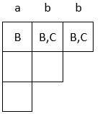
CYK Algorithm in Detail
The first row is handled separately, checking if the substring of length 1 is generated by any production
The non-terminals that produce that character are added to the cell.

Slide 15
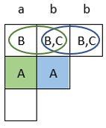
CFG to CNF in Detail
Each subsequent row increases the length of the substring
Each cell is filled with all non-terminal variables that can generate that substring

Slide 16
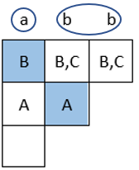
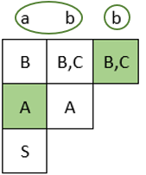
CFG to CNF in Detail
For the last cell we are considering all ways to break up the string into lengths of 1 and 2
we already found all ways to generate substrings of lengths 1 and 2 for previous layers

Slide 17
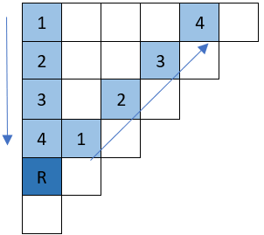
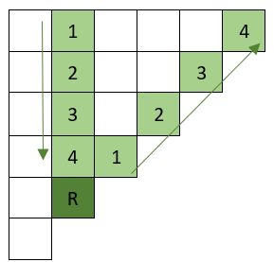
CFG to CNF in Detail
This pattern is predictable and continues for larger arrays. In this next example the fifth row is being filled
For each cell along the row this pattern must be iterated through.

Slide 18
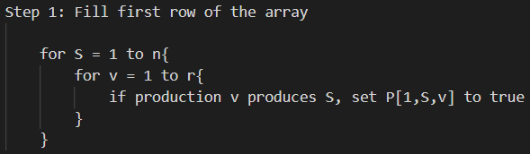
CYK Algorithm Pseudocode

Slide 19
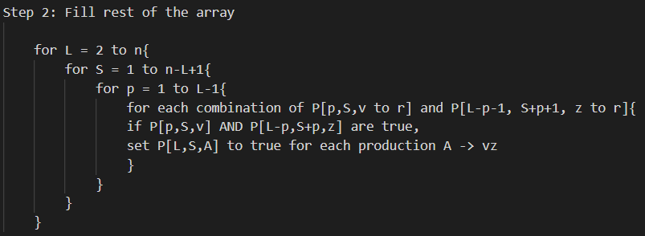
CYK Algorithm Pseudocode

Slide 20
Demonstration
Test cases

